Slide 1
CocoonifiAi
Facial Recognition

Slide 2
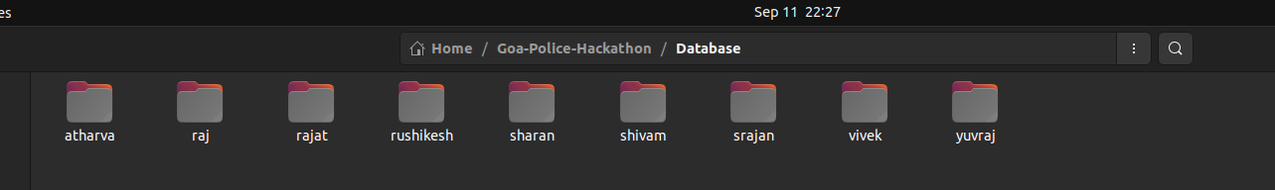
About Model Dataset
The Model will learn to recognise faces from the local database.
Only one images is sufficient for the model to recognise the person.

Slide 3
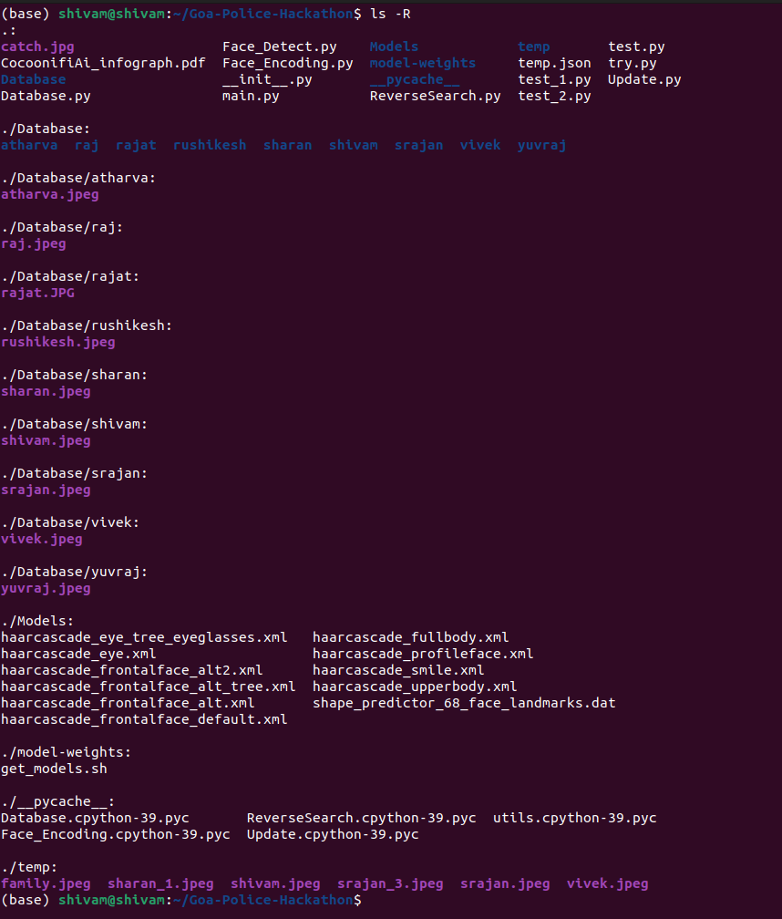
About The DataBase
In the DataBase, each folder only contains one image.

Slide 4
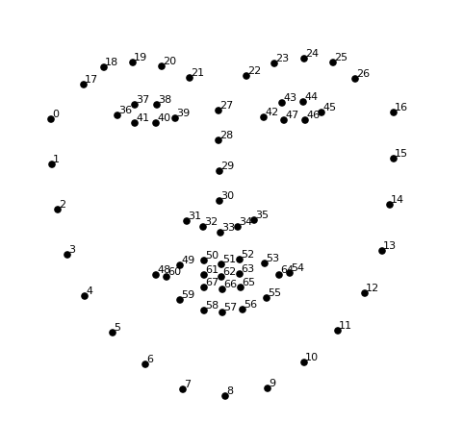
About The working of the Model
The model will extract features from the face which will will be unique to each person and then uses a SVM to recognise the face and if the match is not present in the database then it show unknown.

Slide 5

Good Light Condition and Multiple Detection.

Slide 6
Low Light Condition and Multiple Detection.

Slide 7
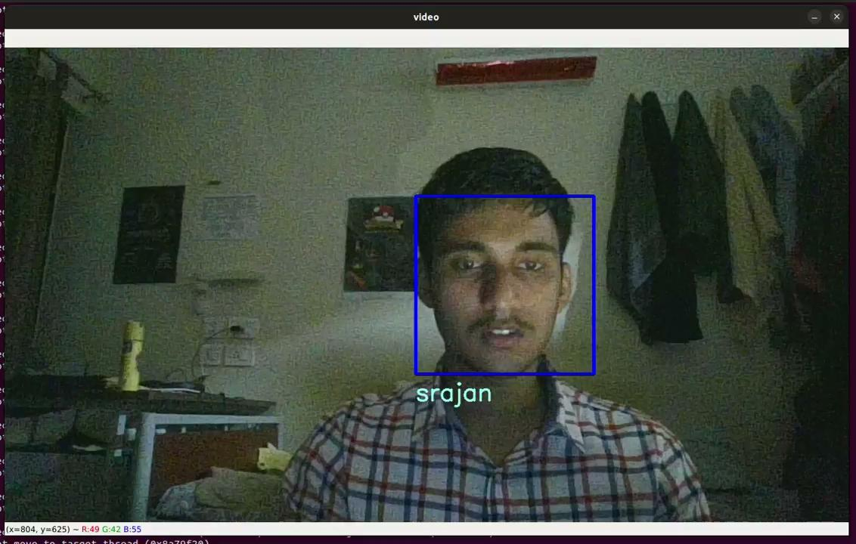
Dim Light Condition and Multiple Detection.

Slide 8
Reverse Search
We have also provide an option to do a reverse search on the unknown face to get it's reverent search images and url and also the metadata of those images.

Slide 9
Thanks!
CocoonifiAi
Srajan Chourasia
Shivam Sinoliya
IIT Goa

